Slide 1
Bitcoin Price Prediction
AI & ML
Markus Köfler

Slide 2
For Report
# statistics behind LSTMs (statsquest)
# hidden layer (vector of inputs, not 10 LSTM nodes)
# getting graphs right … How can predictions be so far off from the last day ??

Slide 3
Learning Task
# Supervised Learning Project
# Time Series Prediction
# (Multiple) Linear Regression vs. (Recurrent) Neural Networks

Slide 4
Learning Task
# the aim of the project is to prove the efficient market
hypothesis (EHM) wrong
# the EMH claims, that all relevant factors are already
reflected by current asset prices and thus, the market
cannot be beaten

Slide 5
Learning Task
# millions of different events happening every single day
moving asset values’ prices up or down
# these events are to the most part uncorrelated amongst
each other, so we can assume they are random in the short run
(weeks, months)
# can a ML model predict the price of BTC better than just
random guessing?

Slide 6
Literature
# In spite of the EMH, many people have already been rather
successful in forecasting asset markets by training various
Neural Nets on historical data
# in his trials, Nils Karlsson states that both the linear
regression and basic Feed Forward NN give more profit than
investing randomly
Nils Karlsson, Comparison of linear regression and neural networks for stock price prediction, Uppsala Universitet , https://www.diva-portal.org/smash/get/diva2:1564492/FULLTEXT02

Slide 7
Literature
# researchers Jaquart, Dann and Weinhardt aimed to train a model which trades bitcoin
# comparison of Neural Networks with and without memory components, tree-based
models, regression models, and ensemble models
# the best scores were achieved with an LSTM model
# gain of 30% could not be turned into actual profit due to accumulation of transaction costs
Patrick Jaquart, David Dann, Christof Weinhardt, Short-term bitcoin market prediction via machine learning, The Journal of Finance and Data Science, Volume 7, 2021, Pages 45-66, ISSN 2405-9188, https://doi.org/10.1016/j.jfds.2021.03.001.

Slide 8
Prediction on (related) Variables

Slide 9
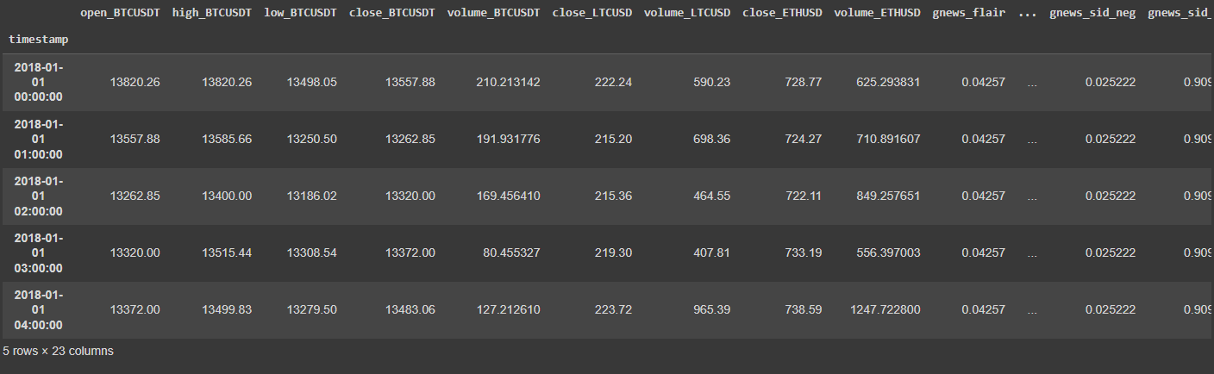
The Data

Slide 10
The Data

Slide 11
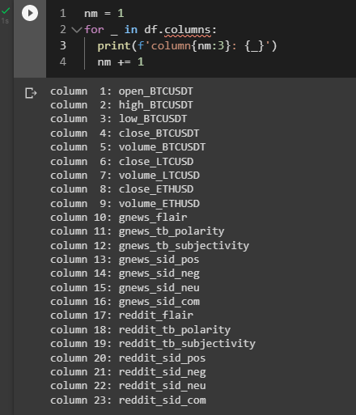
The Data
# all 23 columns
# from column1 to column9:
prices of cryptocurrencies
# from column10 to column23:
sentiment of SM posts

Slide 12

(Multiple) Linear Regression with
# ML library which automates tedious tasks
# data preparation (accepts Pandas DataFrame)
# automatic evaluation of different models
# simple API and syntax

Slide 13
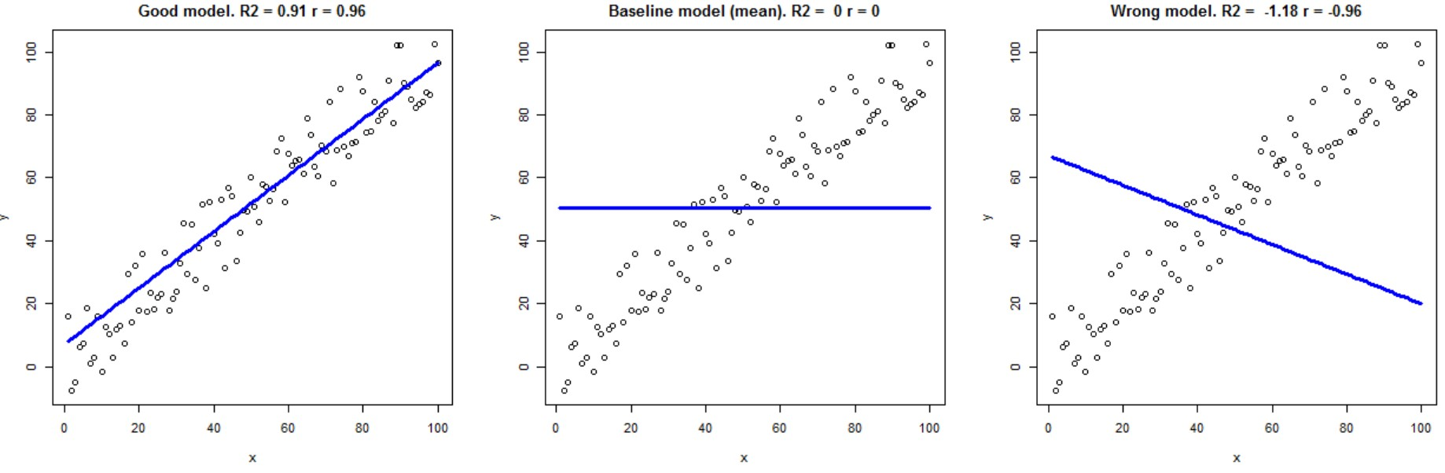
Evaluation Criteria: R-squared
# commonly used R-squared value (coefficient
of determination) as measure for variation
explained
# in short, R^2 measures how close the
individual observations fall to the
regression line - if all points lie
on the regression line, the R^2 will be 1
# it is the squared correlation coefficient
of two variables

Slide 14
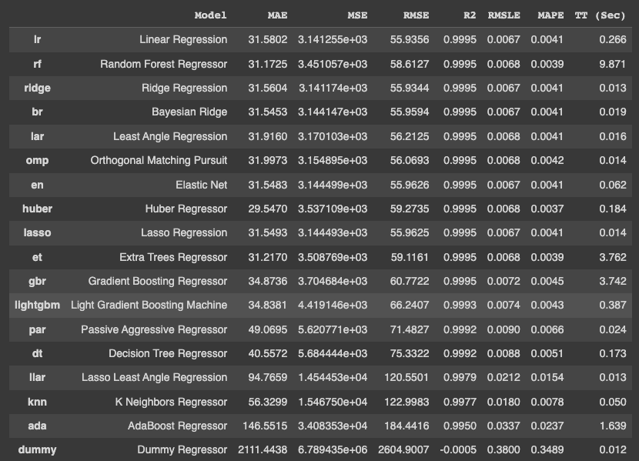
Choosing a Model

Slide 15
Initial Experiment and Outcomes - Train/Test
# first run: hiding randomly selected values throughout the
time series from the model
# second run: hiding the last 100 observations of the time
series from the model

Slide 16
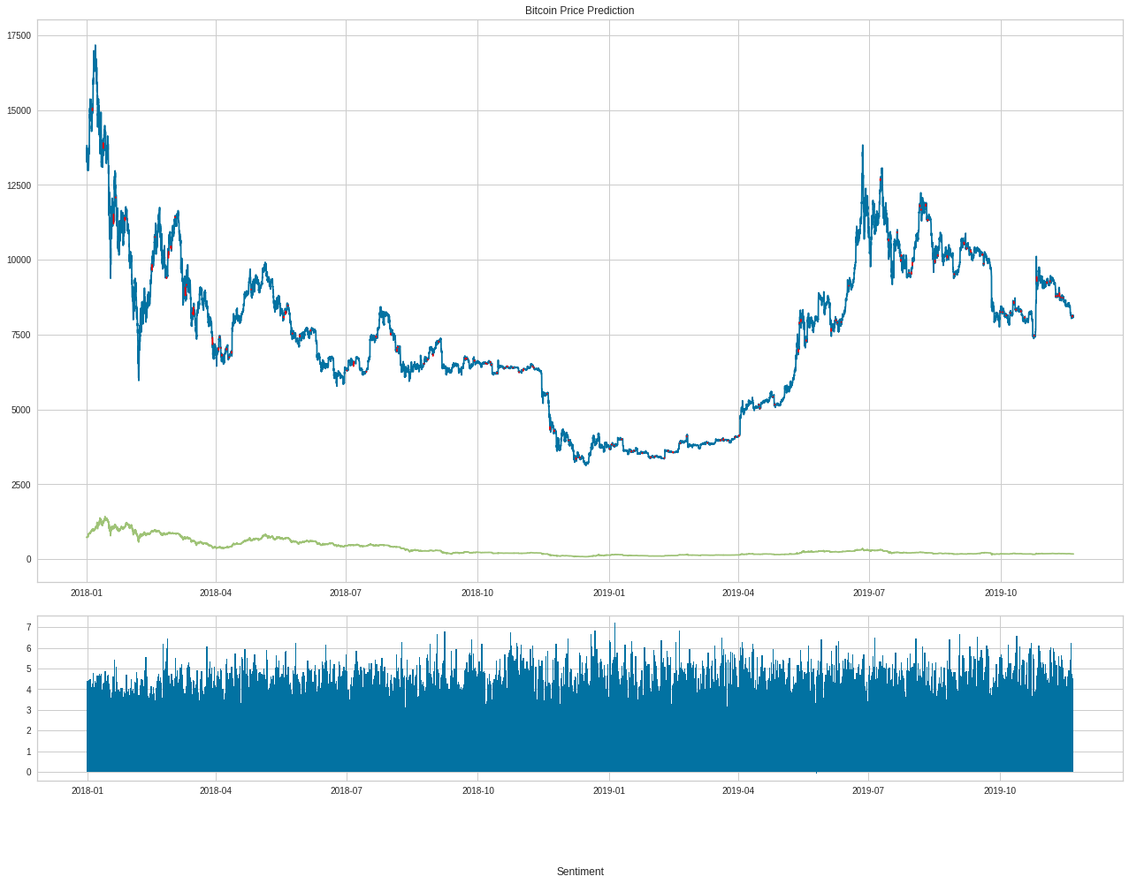
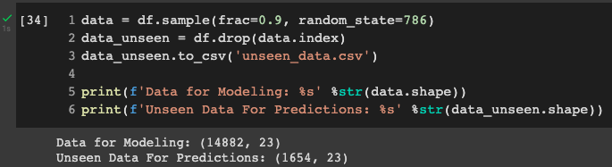

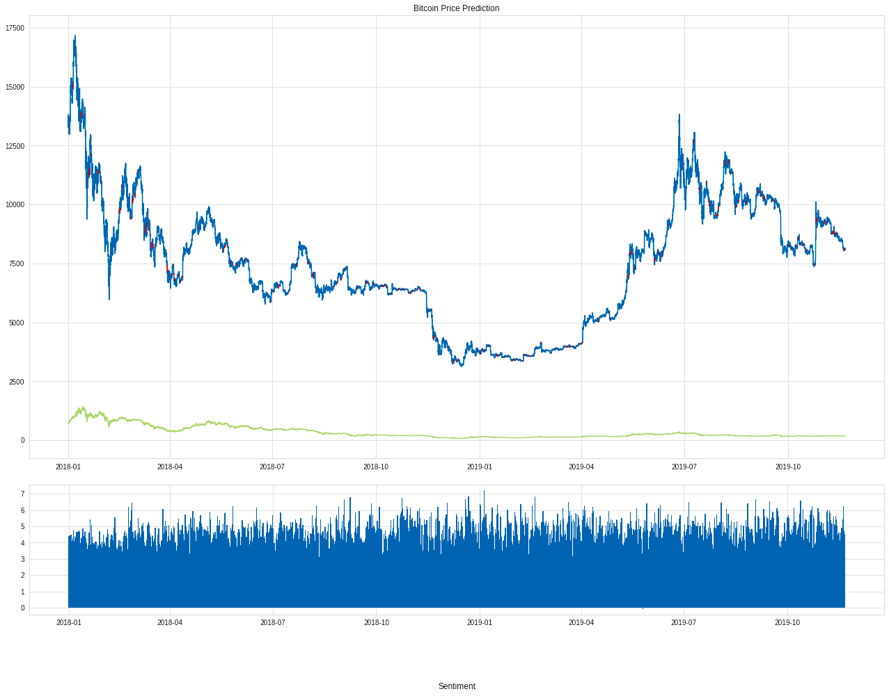
90% Test Data & 10% (random selection)

Slide 17

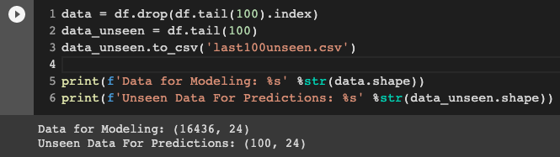

Last 100 observations unseen (at the end)

Slide 18
Feature Selection of Linear Regression
# are more features and observations better for
accuracy?
# a simpler model should always be preferred

Slide 19
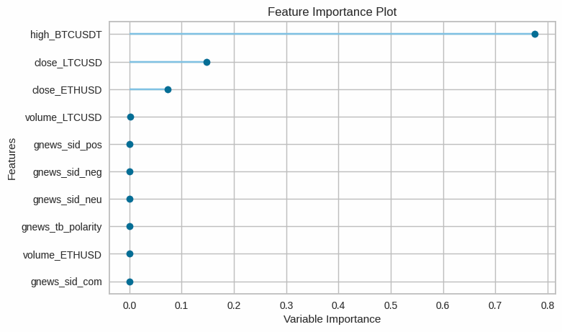
Only 3 variables have been used to predict the masked open_BTCUSDT price

Slide 20
Redundant Features?
# only 3 features out of 22 have a considerable share in the
prediction of the BTC price!
# the sentiments of the SM posts regarding crypto currencies
are entirely ignored due to insignificance!

Slide 21
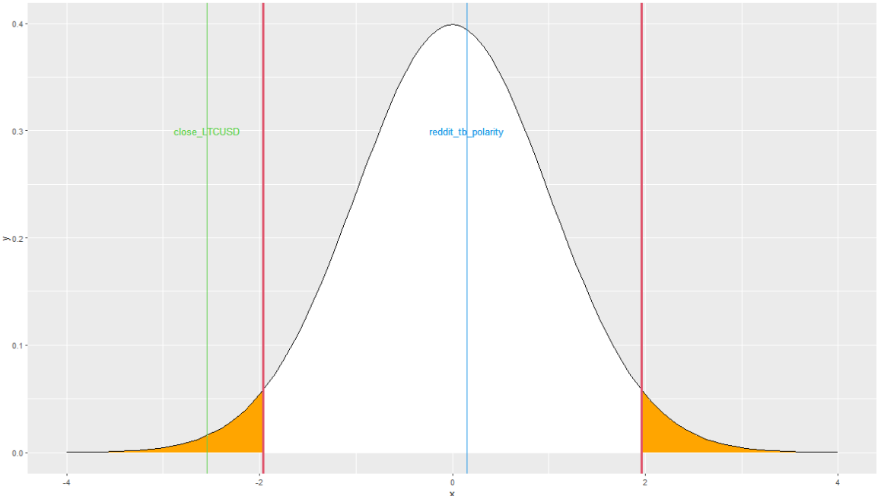
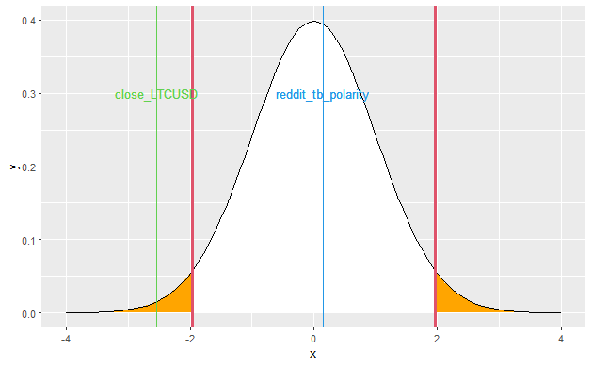
Statistics: Prior Significance Test of Features
# two-tailed t-test
at significance level
𝛼 = 0.05
# H0: feature_x = 0
# close_LTCUSD falls
into rejection region
signaling H1: ≠ 0

Slide 22
What the LM could look like - removing redundant Features
Y = b0 + 0.8921*X1 + 0.0732*X2 + 1.142*X3 + u
Y -> predicted close_BTCUSDT
b0 -> intercept y-axis (baseline if all X_j are 0)
X1 -> high_BTCUSDT
X2 -> close_LTCUSD
X3 -> close_ETHUSD
u -> random error term (difference of actual value and predicted value)

Slide 23
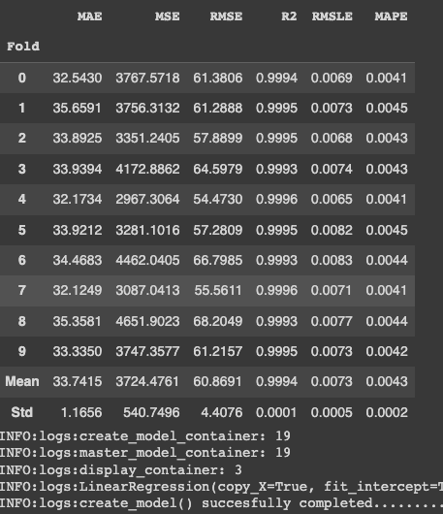
Experiment: What happens if we only train the model on those 3 Features?
# omitting redundant
variables does not
negatively impact our
linear model

Slide 24
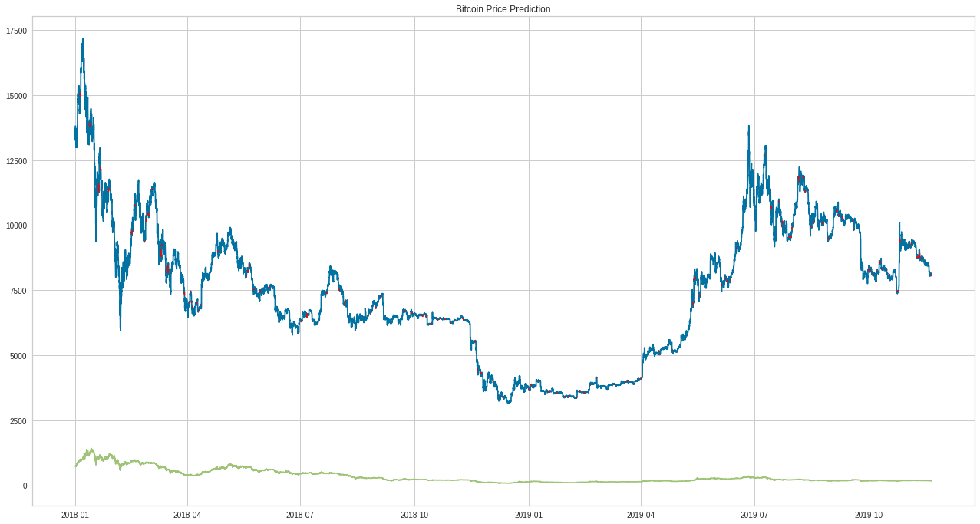
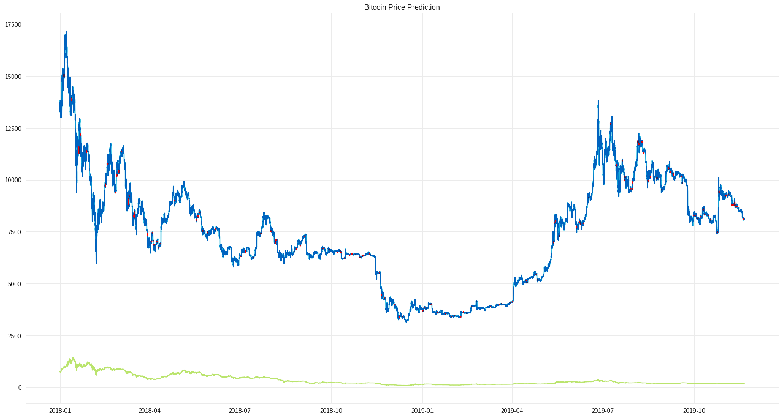
Experiment: What happens if we only train the model on those 3 Features?

Slide 25
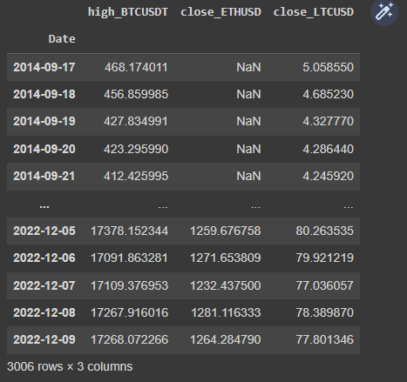
Let’s see how it performs on an completely unseen data set
# BTC and LTC prices daily
from 2014-09-17
# ETH price only available
from 2017-09-11

Slide 26
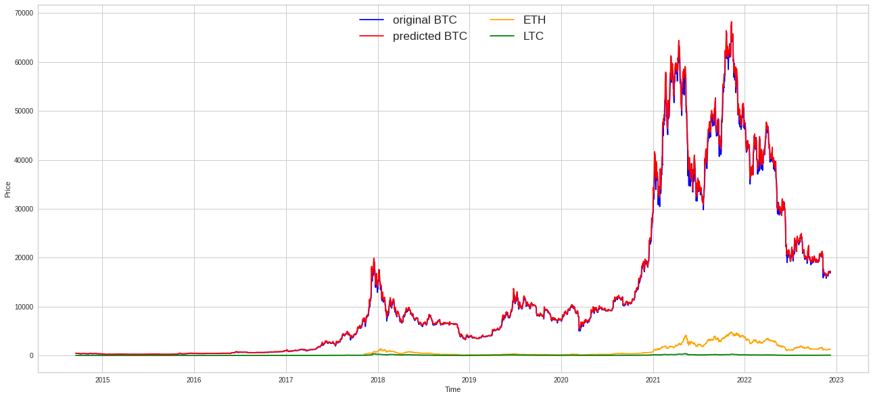
Still pretty good performance!

Slide 27
Why is it so accurate??!!
# many closely related variables (e.g. open_BTCUSDT highly
correlated to high_BTCUSDT)
# kind of misleading, since we wanted to forecast the price
of Bitcoin - but in what real-live situation do we
already have the prices for cryptocurrencies from the
future?

Slide 28
Linear Regression does very well when using only one input variable which is closely related to the actual price i.e. high correlation

Slide 29
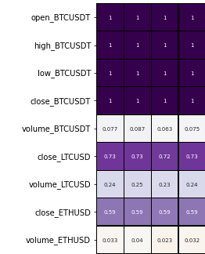
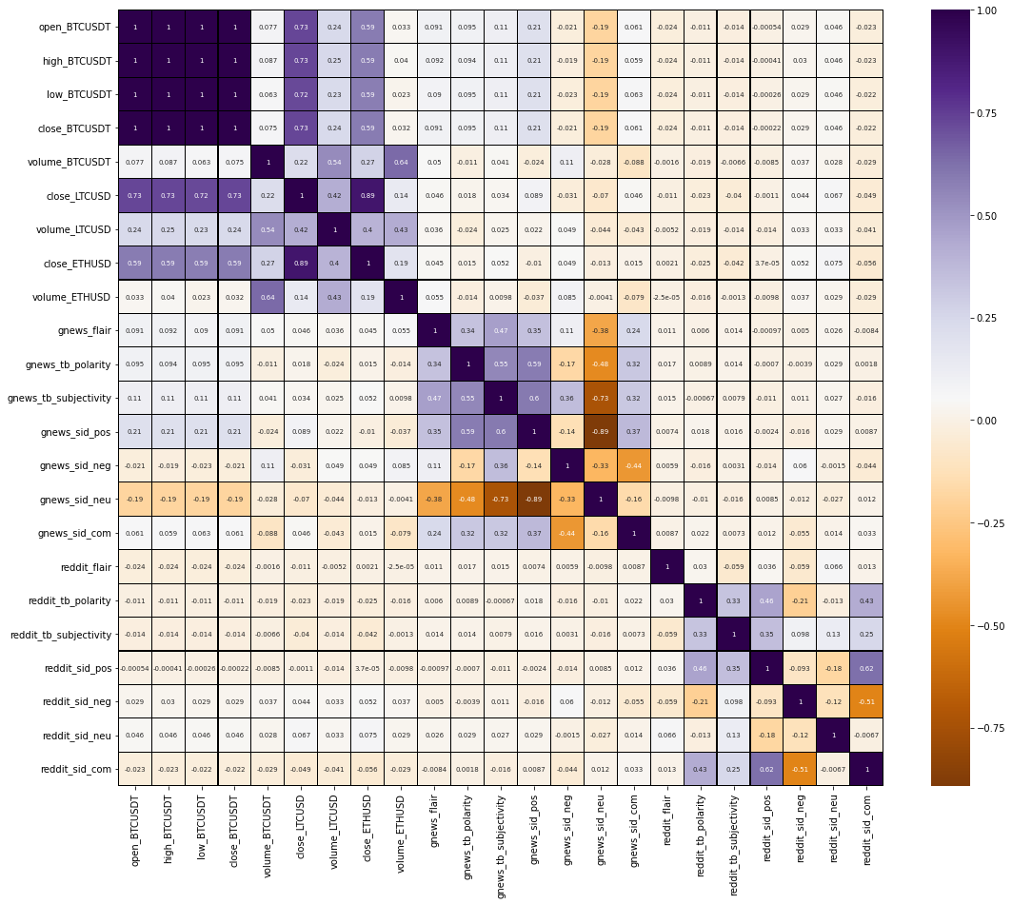
Correlation Coefficient between Predictors – Heatmap
# all x_BTCUSDT variables
are perfectly correlated
# close_LTCUSD and
close_ETHUSD are also
strongly and moderately
positively correlated
respectively to open_BTCUSDT

Slide 30
Conclusion to Linear Regression
# everyone of you could compete or even outperform the model
# taking the high_BTCUSDT price and multiply it by 0.99 and
you most likely end up with a very accurate prediction

Slide 31
Prediction on Observations from the Past

Slide 32

Multiple Regression with
# prediction based on the last 3 days
# The Model:
Target ~ Target-1 + Target-2 + Target-3
“today’s price [Target] regressed on (~) the price of yesterday [Target-1],
the day before yesterday [Target-2] and the price of 3 days ago [Target-3]”
# Estimated Model form:
Y = b0 + b1*X1 + b2*X2 + b3*X3 + u

Slide 33
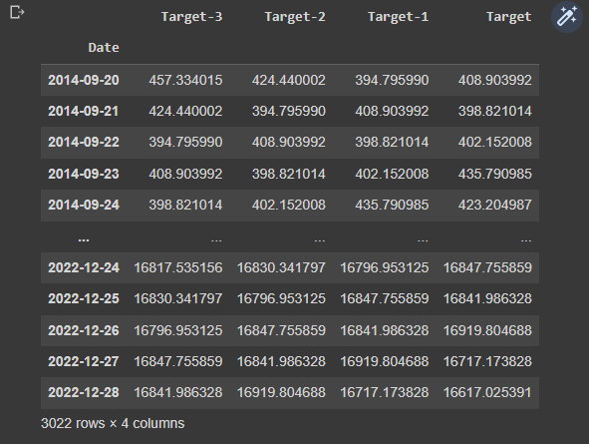
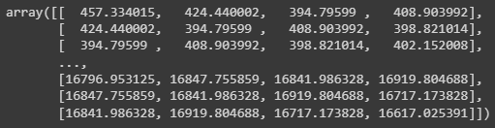
Data Engineering
# Target-3 = 3 days in the past
# Target-2 = before yesterday
# Target-1 = yesterday
# conversion to numpy.array()

Slide 34
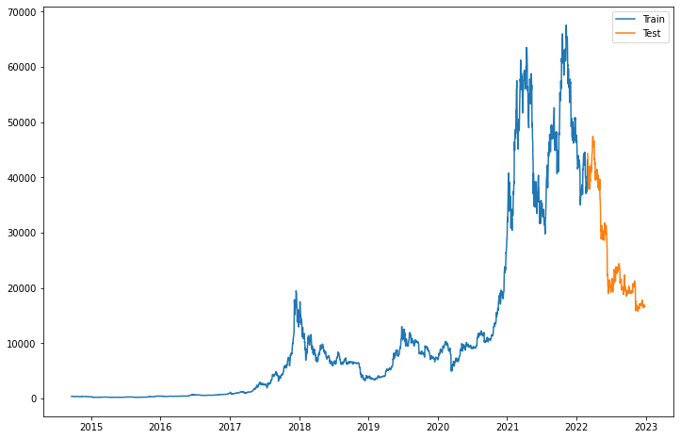
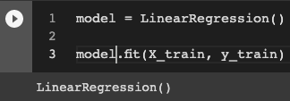
Splitting Dataset 80/20 & initializing the Model

Slide 35
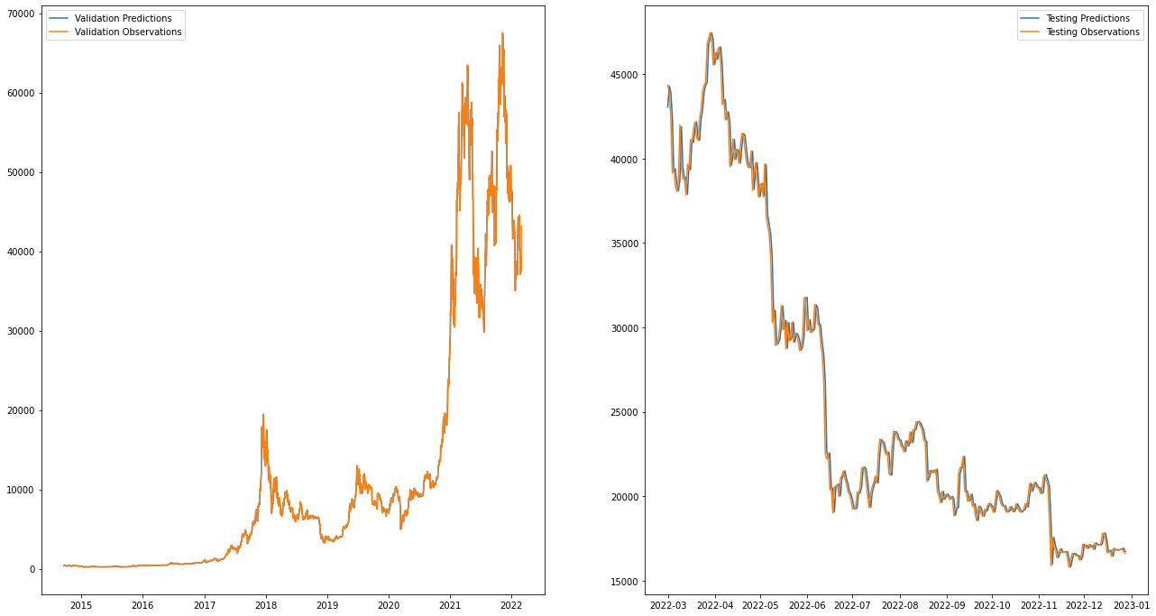
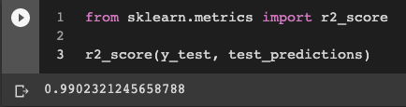
Performance of Multiple Regression Model

Slide 36
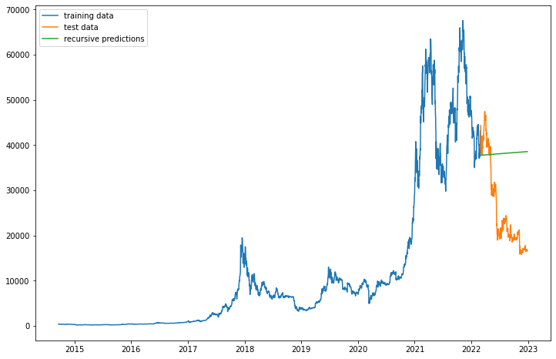
Recursive Prediction using the Multiple Regression Model

Slide 37
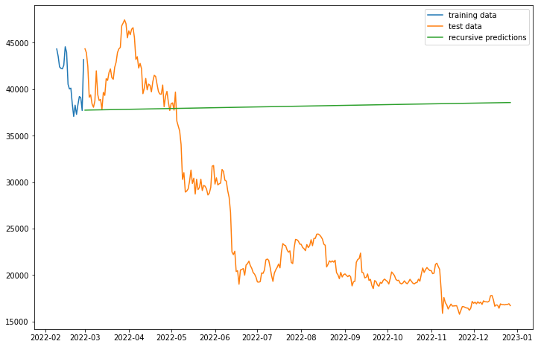
Recursive Prediction using the Multiple Regression Model

Slide 38
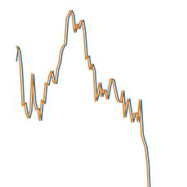
What happened here?
∆ > 0
the model(‘s coefficient) always predicts a slightly higher value than the actual price, therefore, the model recursively predicts a slightly higher price over and over again leading to a positive slope

Slide 39
Conclusion to the Regression Model
# pitfall: the regression model in its nature is only capable of predicting
a straight line
# does a great job in predicting (only) the next day
R-squared: 0.99023
# limitation: several predictor variables possible, but only one predicted variable
Hence, we cannot predict multiple days into the future
# it is not possible to consider fluctuations

Slide 40
Long-Short-Term Memory (LSTM)
# essentially a RNN which implements memory cells to preserve previous
information, thus, handles the problem of vanishing gradients
# vanishing gradients (derivatives) of the parameters become quite small
due to iterative multiplication with a fixed weight matrix
# vanishing gradients as main cause for inability of regular RNNs to learn
long-term dependencies from the data
# application in NLP and Time Series Forecasting

Slide 41
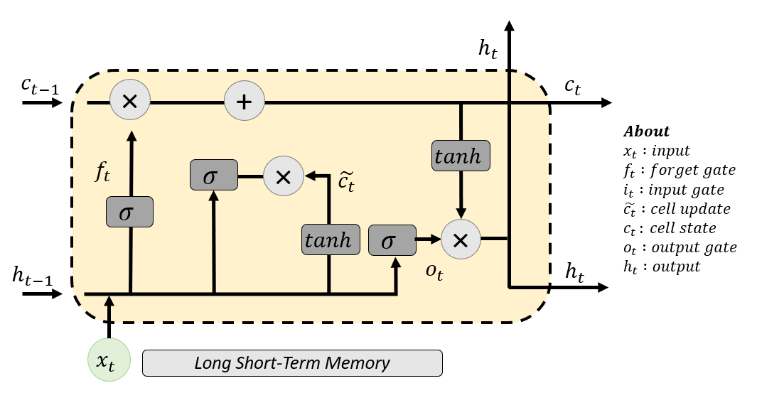
Long-Short-Term Memory (LSTM)
# using special gates, memory cells
preserve information from previous
steps and decide what to keep and what
information to get rid of (forget gate)
# This way, a LSTM can develop an
understanding of patterns in the
data and make more accurate predictions

Slide 42
Limitations of LSTMs w.r.t Time Series Forecasting
# LSTMs assume stationary data i.e. that mean and variance are time-invariant,
however, those statistics change with time, impacting the model’s performance
# overfitting for complex models (learning data by heart instead of
understanding patterns)
# slow training on large data sets due to sequential processing
# challenging to choose hyperparameters e.g. the appropriate window size (number of
previous time steps as inputs)

Slide 43
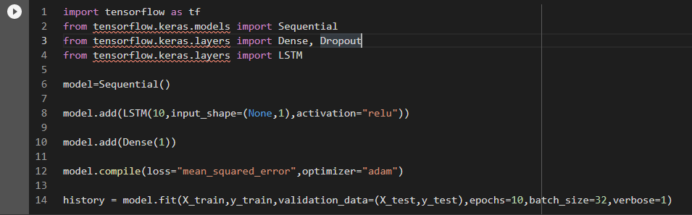
The Model
# playing around with the hyperparameters lead me to the
best performing model:
# LSTM(10,-> 10 LSTM nodes
# batch_size -> sampling size
(faster training, less
variation, results don’t
change much for smaller
batches)
# input_shape -> None adjusts to
batch size
# Dense(1) -> one output node

Slide 44
The Model
Input Layer Hidden Layer Output Layer
LSTM
# very simple and modest
construction
# hyperparameter tuning
requires time, effort
and knowledge!
LSTM
X1
LSTM
LSTM
X2
LSTM
LSTM
Dense
Y
X3
LSTM
.
.
.
LSTM
LSTM
X32
LSTM
LSTM

Slide 45
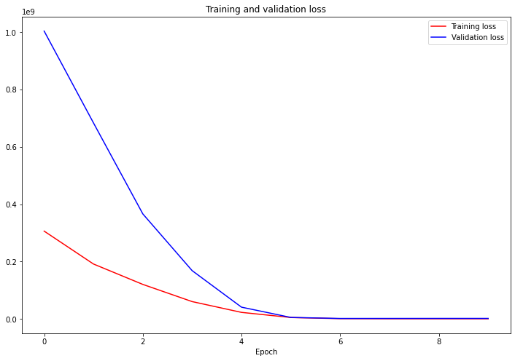
Training and Validation Loss
# concave loss function
# indicating decreasing
marginal loss
# no indication of
overfitting (no increasing
validation loss)

Slide 46
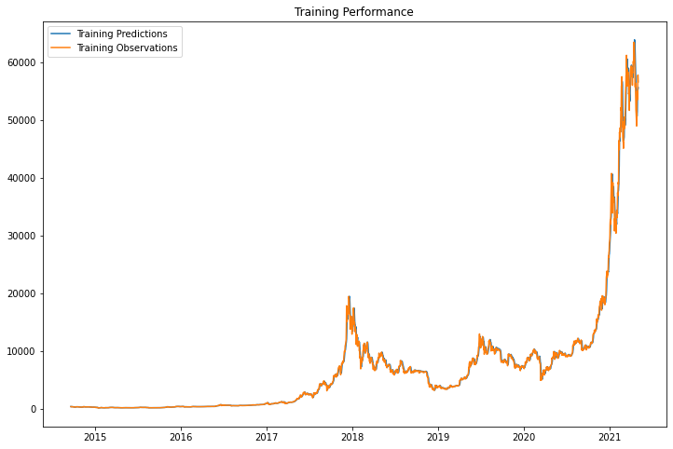
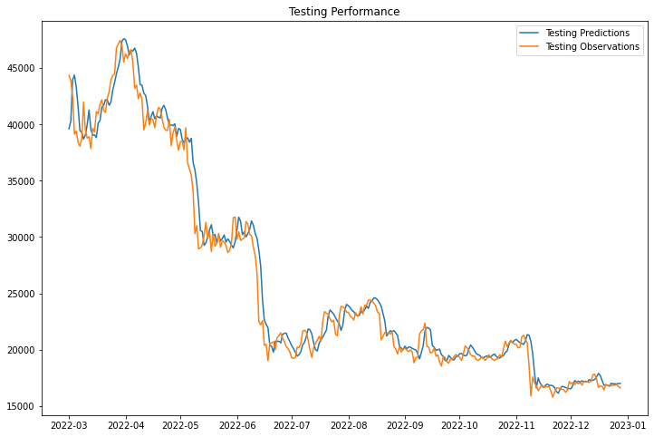
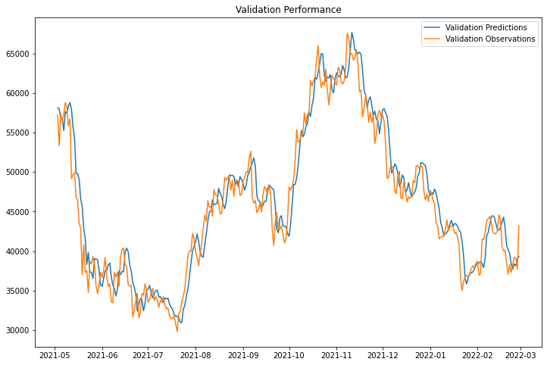
Training, Validation, Testing

Slide 47
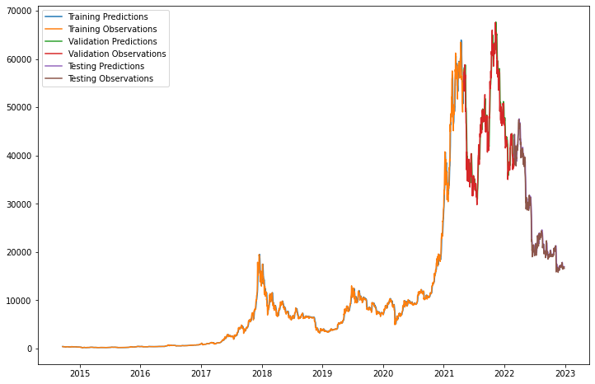
LSTM Performance
# great performance in
predicting the price
given the last 3 days

Slide 48
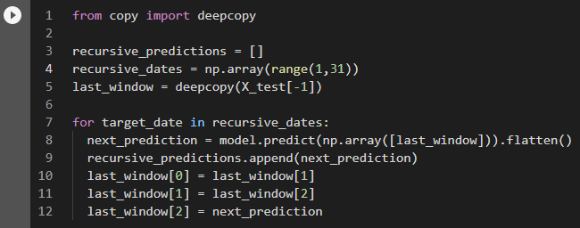
30 Days Recursive Prediction
# prediction becomes yesterday
# yesterday becomes the day before yesterday and so on…

Slide 49
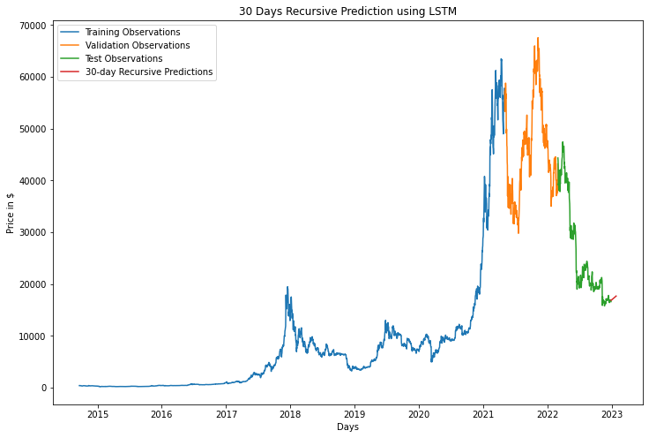
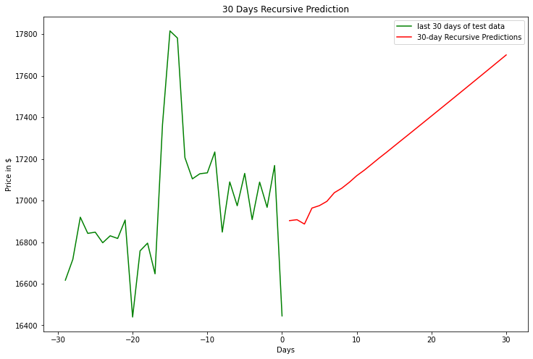
30 Days Recursive Prediction based on the last 3 Days

Slide 50
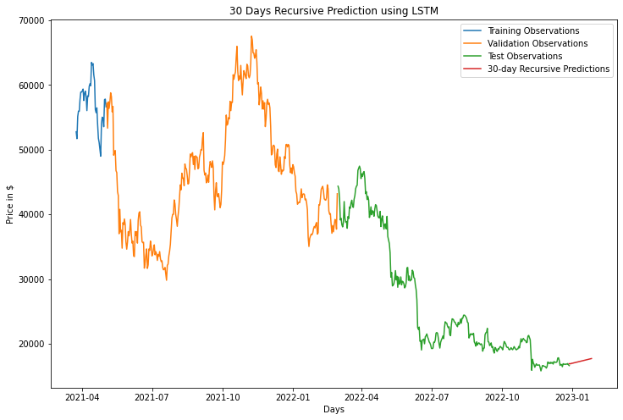
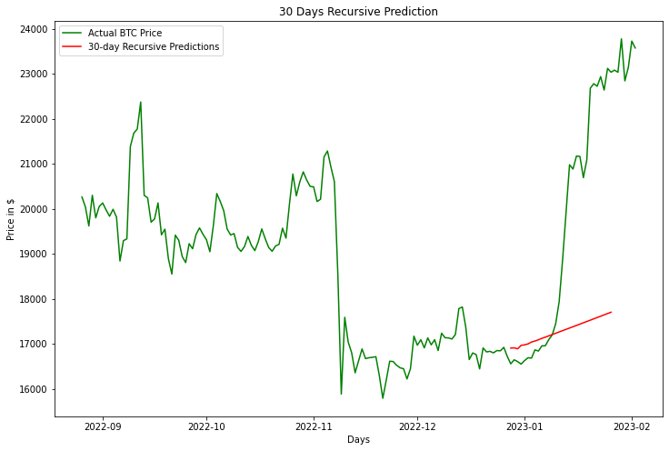
30 Days Recursive Prediction based on the last 3 Days

Slide 51

30 Days Recursive Prediction based on the last 3 Days

Slide 52
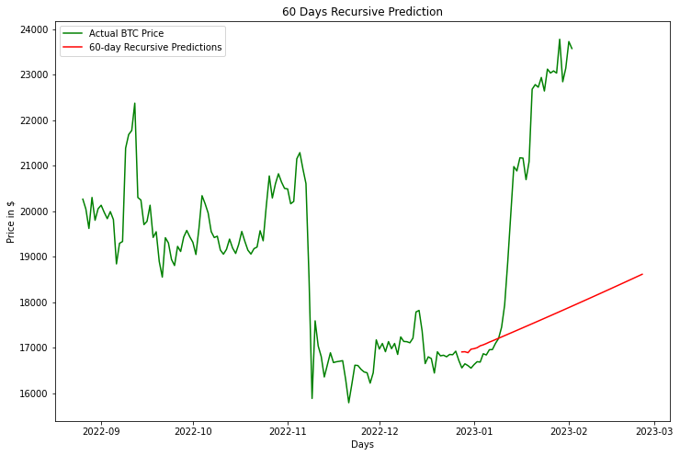
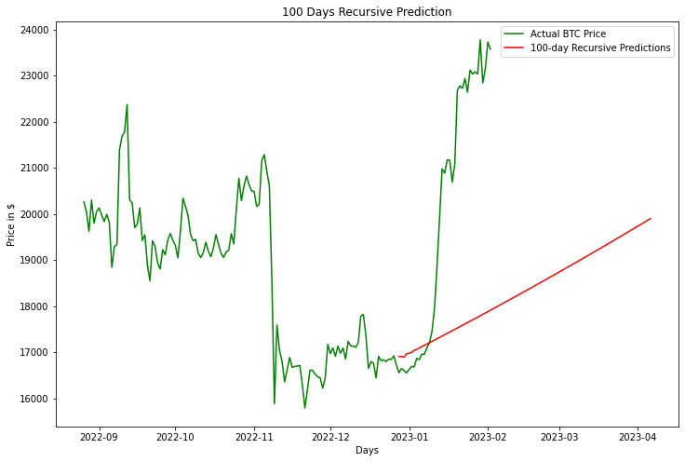
60 & 100 Days Recursive Predictions

Slide 53
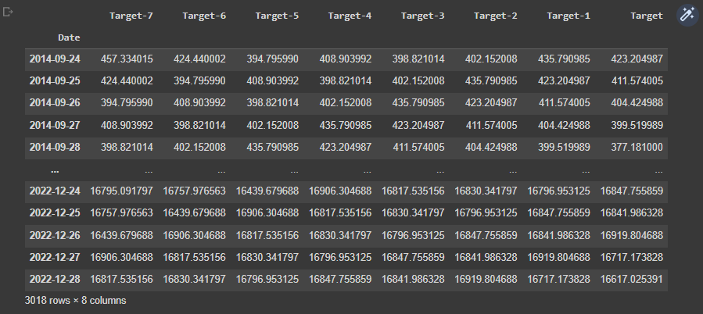
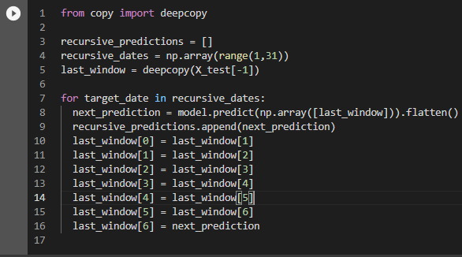
Experiment: Recursive Prediction based on the last 7 Days
# hyperparameters are the same
as before
# altered number of epochs from 10
to 100
# loss took longer to decrease

Slide 54

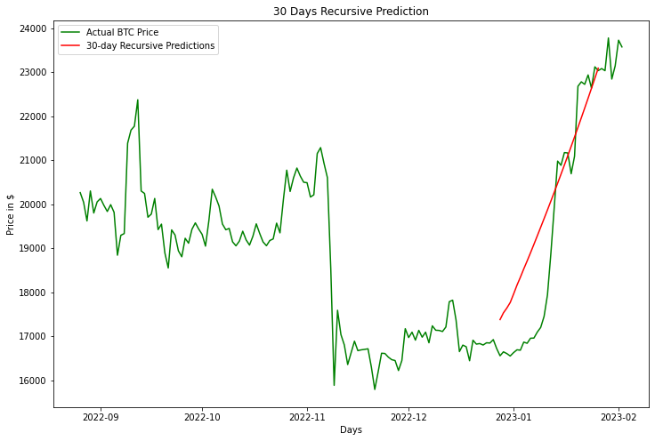
30 Days Recursive Prediction based on the last 7 Days

Slide 55

30 Days Recursive Prediction based on the last 7 Days

Slide 56
Comparison: last 3 Days vs. last 7 Days
# recursive prediction on the last 7 days performs better

Slide 57
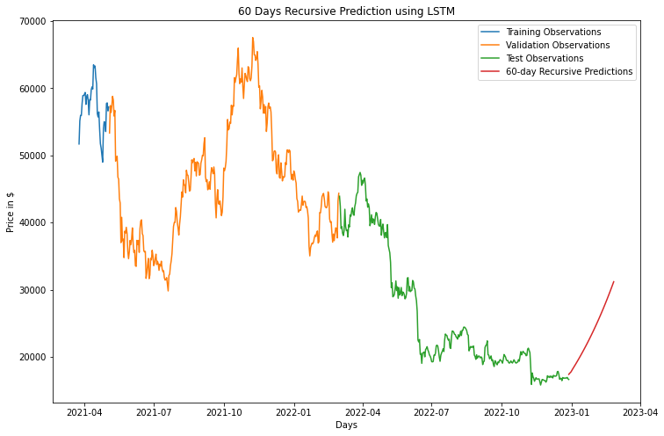
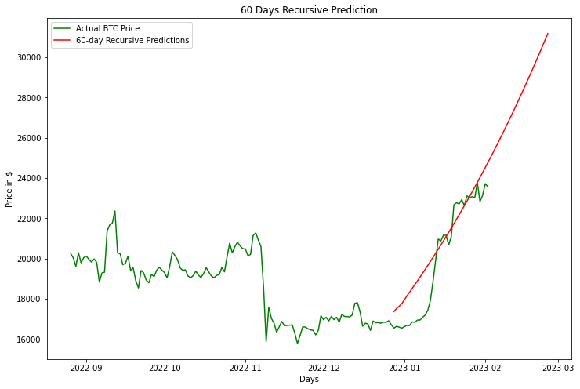
60 Days Recursive Prediction based on the last 7 Days

Slide 58
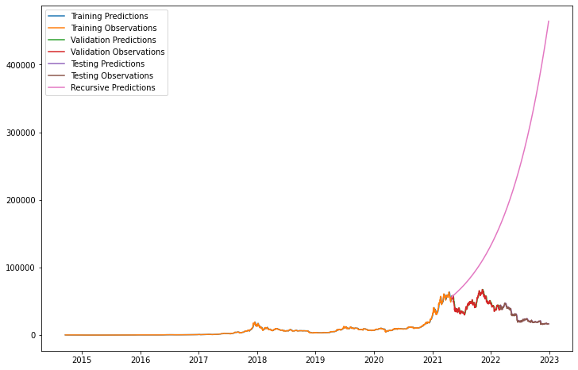
Limitations
# gains momentum & takes off
# exponential growth?
# the longer the time horizon
the more inaccurate it becomes
# only predicting one day ahead
is probably not enough

Slide 59
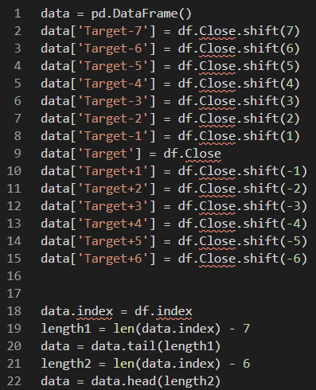

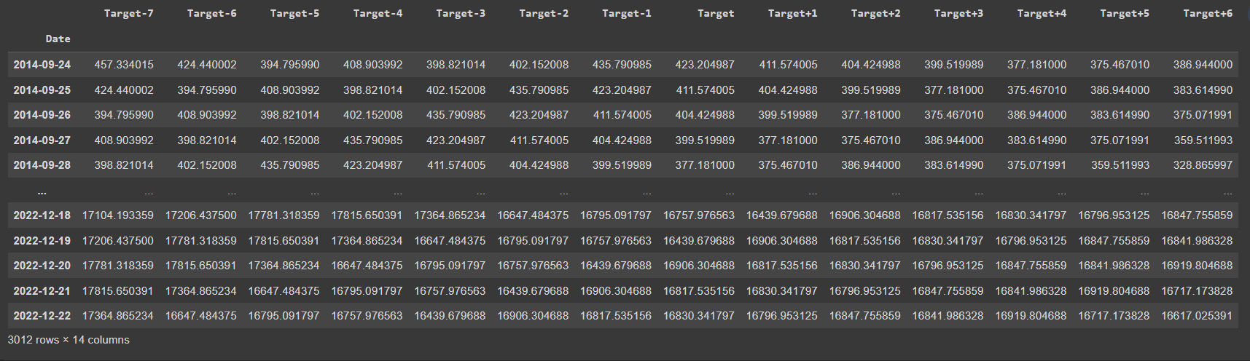
7 Day Prediction based on past 7 Days

Slide 60
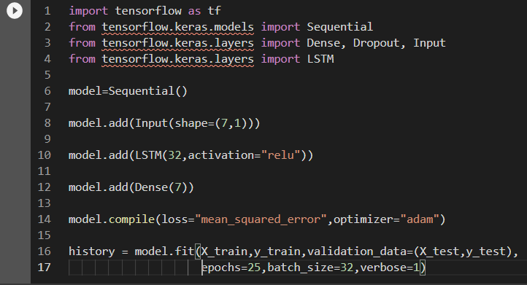

The new Model

Slide 61
The new Model
Input Layer Hidden Layer Output Layer
LSTM
# 7 Output Layers for each
day of the week Predicted
# 32 LSTM nodes instead
of 10
# Y is a 2-dimensional array
(matrix) with 1 row and
7 columns
X1
Dense
LSTM
LSTM
Dense
X2
LSTM
Dense
LSTM
Y
X3
Dense
LSTM
.
.
.
LSTM
Dense
LSTM
Dense
X32
LSTM
...
Dense
LSTM

Slide 62
The new Model
Input Layer Hidden Layer Output Layer
LSTM
# 7 Output Layers for each
day of the week Predicted
# 32 LSTM nodes instead
of 10
# Y is a 2-dimensional array
(matrix) with 1 row and
7 columns
X1
Dense
LSTM
LSTM
Dense
X2
LSTM
Dense
LSTM
Y
X3
Dense
LSTM
.
.
.
LSTM
Dense
LSTM
Dense
X32
LSTM
...
Dense
LSTM

Slide 63

One Week ahead Prediction

Slide 64

3 Week Recursive Prediction
# one week prediction into the future
# using those prediction to predict the next week…

Slide 65



3 Week Recursive Prediction

Slide 66
Resources
# Online Resources
# Libraries & Documentation
# YouTube # Google Colaboratory
# GitHub # Yahoo! Finance
# Stack Overflow # Towards Data Science
# pandas # pycaret
# numpy # tensorflow/keras
# matplotlib # deepcopy
# seaborn # pickle

Slide 67
Suggestions for Improvements w.r.t Time-Series Forecasting
# implementing other factors but the price
# normalization of data (subtract mean, divide by std.deviation)
# adjusting the architecture of the model to the data and the task
# reasonable hyperparameter optimization

Slide 68
Thank You!

